Slide 1


Advanced Principles I
Principles of
Object-Oriented Class Design
Copyright © 1998-2006 by Object Mentor, Inc
All Rights Reserved
Portions of this material are Copyright © 1998, by Addison Wesley Longman,Inc. and have been reproduced here with permission.

Slide 2
Dependency Management
What is dependency management?
What bearing does DM have on software?
What is the result of poor DM?
What is the advantage of good DM?

Slide 3
What is dependency management?
A simple idea - as interdependencies increase, features like reusability, flexibility, and maintainability decrease.
Dependency management is controlling interdependencies.

Slide 4
What bearing does DM have on software?
Coupling and cohesion are the eternal concerns of software development
One can say that OO is just a set of tools and techniques for Dependency Management

Slide 5
What is the penalty for practicing poor DM?
A system with poor dependency structure will typically exhibit these four negative traits:
It is rigid
It is fragile
It is not reusable
It has high viscosity

Slide 6
It is Rigid
Rigidity is the inability to be changed
The impact of a change cannot be predicted
If not predicted, it cannot be estimated
Time and cost cannot be quantified
Managers become reluctant to authorize change
Official Rigidity for “Roach Motel” modules

Slide 7


Changes with Rigidity
Officially Rigid Area
The System
Where the change should be made
Where the change must be made now
Are we containing risk, or spreading rot?
Notes:
This may be the reason why so many systems have to be rewritten from scratch after some number of years. By designing and maintaining systems that cannot accept changes gracefully, we have an unplanned but inevitable obsolescence.
This may very well be a design problem, not a coding or maintenance problem.

Slide 8
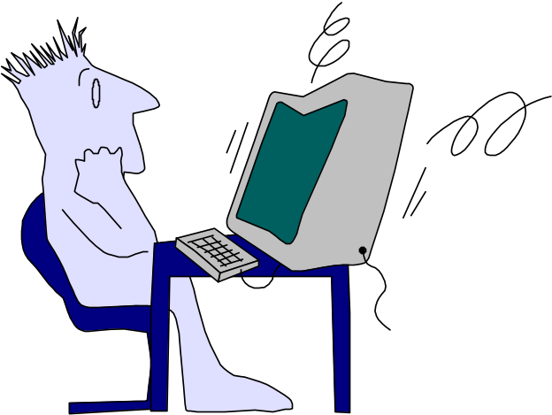
It is Fragile
Software changes seem to exhibit non-local effects
A single change requires a cascade of subsequent changes
New errors appear in areas that seem unconnected to the changed areas
Quality is unpredictable.
The development team loses credibility

Slide 9
Increasing Risk
Defects v. Cumulative Modifications
1.0
Probability of
introducing a bug
Changes
Systems tend to become increasingly fragile over time. Intentional, planned
partial rewrites may be necessary to sustain growth and maintenance.
Notes:
When dependencies are not carefully managed, a functional change will most likely require modifying multiple modules. There is an opportunity to introduce a bug in each module. There are also opportunities to introduce side affect bugs. As changes are made, and the original design deteriorates, the probability of introducing a bug, with a bug fix grows.
Frequently-maintained modules must be separated from infrequently maintained modules. Otherwise, we suffer frequently upheaval. The design principles taught in this class will help to separate them.

Slide 10
It is not reusable
Desirable parts of the
design are dependent
upon undesirable parts
The work and risk of
extracting the desirable
part may exceed the
cost of redeveloping
from scratch.
Notes:
.

Slide 11
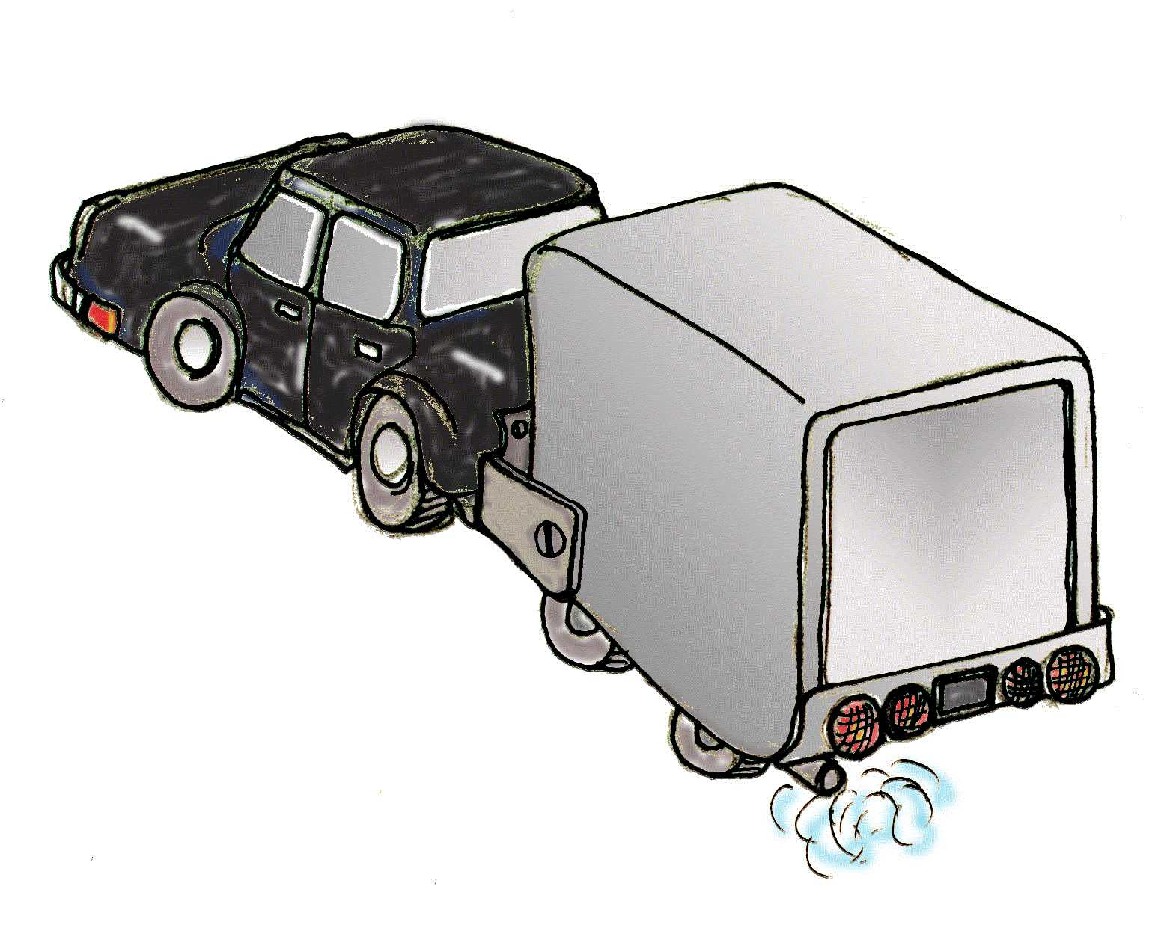
The Trailer
The Trailer

Slide 12
It has high viscosity
Viscosity is resistance to fluid motion.
When the “right changes” are much more difficult than hacking, the viscosity of the system is high.
Over time, it will become increasingly difficult to continue developing the product.
Notes:
You can recognize the symptom this way: the rate of change in requirements is more-or-less constant, but the amount of labor required to produce the changes continually increases.
Eventually, the company will not be able to afford to maintain the software at all. They will have to refuse to satisfy customer demand temporarily in order to rewrite the system, they will reduce their responsiveness for a more extended period to rewrite in bits and pieces, or they will become unable to satisfy customer demand anyway and will fail as a software development organization.
Ideally, the same number of programmers should be able to satisfy a constant rate of change indefinitely. Poor dependency management will ensure that the ideal will not be reached, or even reasonably approximated.

Slide 13




What is the benefit of good DM?
Interdependencies are managed, with firewalls separating aspects that need to vary independently.
Less fragile,
the bugs are boxed in
More Flexible
Easier to reuse
Easier to make the right change
Fewer Trailers
Slow the rot
Notes:
Not Rigid
Modules can be changed independently
Changes are focused into a small set of modules
The cost of a change can be estimated.
Changes can be planned with more reliability
Not Fragile
Limited propagation means fewer changes: less risk of introducing defects
New defects are likely to be in the same conceptual area
Risks are more predictable, Credibility remains high
Reusable
Modules can be separated: modules with desirable qualities do not depend on those with undesirable qualities.
Low viscosity
The “right” changes are easy to make, Evil trade-offs are less attractive
Code rot is slowed, if not stopped
The system is more amenable to changes after the initial releases
Clarity is not in the list. Clarity is a good thing, but clarity isn’t everything. A design which is complex may be better than one which is over simplified, for the same reason we build houses instead of lean-tos to live in.

Slide 14
What causes “Code Rot”?
It’s been blamed on stupidity, lack of discipline, and phases of the moon, but...
A case study “The Copy Routine”

Slide 15
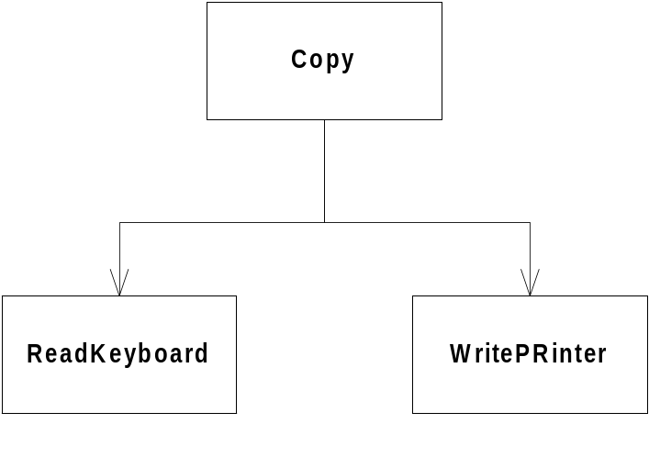
First Version
All designs start well
void copy(void)
{
int ch;
while( (ch=ReadKeyboard()) != EOF)
WritePrinter(ch);
}
The program is an overnight success!
How could it be more simple, elegant, and maintainable?
Notes:
This is an intuitive design, it is concise, and you can tell that the bottom two modules (ReadKeyboard and WritePrinter) are probably reusable.

Slide 16
Second Version
Oh, no! Nobody said the requirements might change!
We sometimes want to read from paper tape reader.
We could put a parameter in the call, but we have hundreds of users already!
No big deal, this is just an exception… we can make it work.
Notes:
This is a somewhat contrived-looking example, but we find that concrete implementations and user decisions are changeable. Maybe not on the second release, but eventually many technology choices will change.

Slide 17
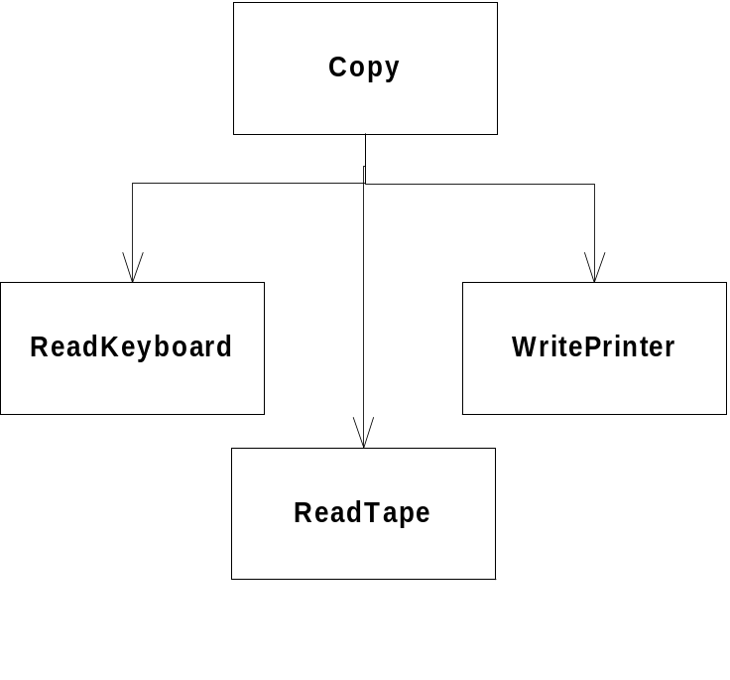
Second Version Design
bool GtapeReader = false; // remember to clear
void copy(void)
{
int ch;
while( (ch=GtapeReader ? ReadTape() : ReadKeyboard()) != EOF)
WritePrinter(ch);
}
Notes:
We depend on the new users of the module, the paper tape folks, to set and unset the flag. They can’t just call the routine. There is more dependency on documentation and memorization.
There is an unwanted side-effect here. Everyone using the copy routine must now link in the paper tape reader routine whether they use it or not. But at least they don’t have to change any of their code.
The old users call the routine the old way, the new users have a little extra protocol to remember.

Slide 18
Third Version
How unexpected! Requirements changed again!
It seems that sometimes we need to write to a paper tape punch. We’ve had this problem before, and just added a flag. Looks like it should work again.
bool GtapeReader = false;
Bool GtapePunch = false;
// remember to clear
void copy(void)
{
int ch;
while( (ch=GtapeReader ? ReadTape() : ReadKeyboard()) != EOF)
GtapePunch ? WritePunch(ch) : WritePrinter(ch);
}
Notes:
Remember that tidy little program we started with? Where did it go?
The trend is clear. Every time the requirements change in this way, we have to edit the code. Every time, link requires more unneeded modules. Every time, the logic is less clear. Every time, there is a chance of accidental error.
Every time, there is more for the callers of the routine defend against. What if one of the flags was left set? Should all callers clear all the flags? There is increasingly more to know in order to use the routine correctly.
Sometimes, simple things refuse to stay simple.

Slide 19
Example of a Good Design
First and only version.
void Copy()
{
int c;
while( (c=getchar()) != EOF)
putchar(c);
}
But wait! Aren’t we supposed to be learning OO design? This isn’t OO is it?
Notes:
Good means:
Flexible - easy to extend
Not fragile - won’t break when we add new IO devices
Reusable - this code can be reused without change by adding IO devices that work with fgetc and fputc
Low viscosity - costs of development don’t increase sharply with the number of releases.

Slide 20
…is it?
It is a small program based on abstractions!
FILE is an abstraction
  It represents some kind of byte stream
  It has many variations
It has methods
  Read, Write, getchar, putchar, etc
  The methods are *dynamically* bound
FILE is a class, just implemented differently.

Slide 21
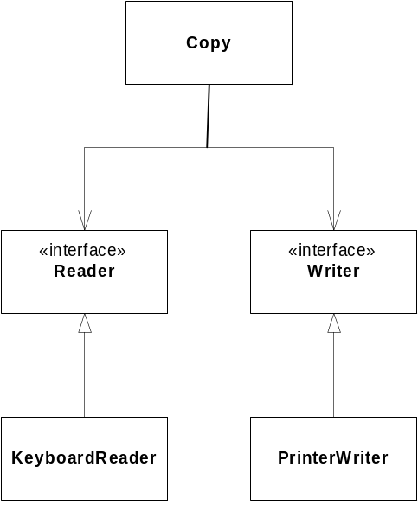
Rephrased in OO
interface Reader
{ char read(); }
interface Writer
{ void write(char c); }
public class Copy
{
Copy(Reader r, Writer w)
{
itsReader = r;
itsWriter = w;
}
public void copy()
{
int c;
while( (c==itsReader.read()) != EOF )
itsWriter.write(c);
}
private Reader itsReader;
private Writer itsWriter;
}
Notes:
This is far less simple than the original version. This is so that we have greater resilience in the face of foreseeable changes. We can use this small and simple program in many different contexts.
Initially, we’d only implement the keyboard reader and printer writer. We’d have a program that completely and *only* fulfilled its requirements. Everything built was needed.
Later we’d build paper tape readers and writers, when they were needed. If they are never needed, the cost of this version is still not very high. It’s a wager that we are likely to win.
Notice that it is very easy to write common copy() routines that use common streams. But notice also that you never link in any implementations you don’t need.

Slide 22
Dependency Management Review
Why do programs tend to rot over time?
What is dependency management?
What are four qualities of good designs?
Are OO programs always simpler than non-OO versions?
Why would anyone want to use a paradigm that may result in more complex designs?
Why are compile and link time important?

Slide 23
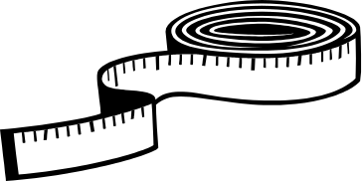
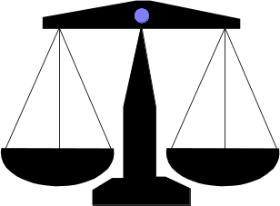
Class Design Principles
From: Agile Software Development: Principles, Patterns, and Practices.
Robert C. Martin, Prentice Hall, 2002.
SRP: The Single Responsibility Principle
OCP: The Open/Closed Principle
LSP: The Liskov Substitution Principle
ISP: The Interface Segregation Principle
DIP: The Dependency Inversion Principle

Slide 24
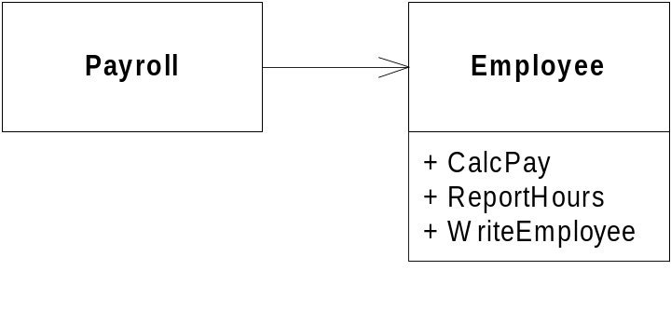
The Single Responsibility Principle
A class should have one, and only one, reason to change.

Slide 25
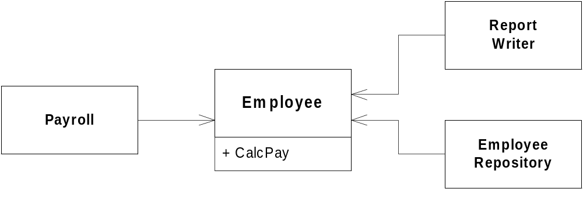
The Single Responsibility Principle. (SRP)

Slide 26
Open/Closed Principle
“Modules should be open for extension, but closed for modification”
-Bertrand Meyer
A principle which states that we should add new functionality by adding new code, not by editing old code.
Defines a lot of the value of OO programming
Abstraction is the key
Notes:
This is the “mother of all design principles”. It states that software should be, well, soft. It should be easy to introduce certain kinds of changes -- those that we could anticipate.

Slide 27
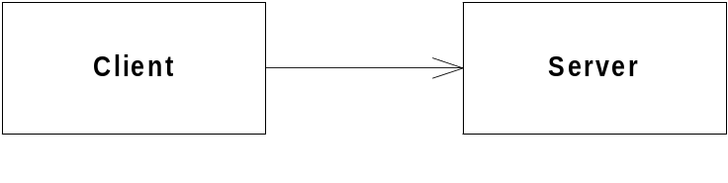
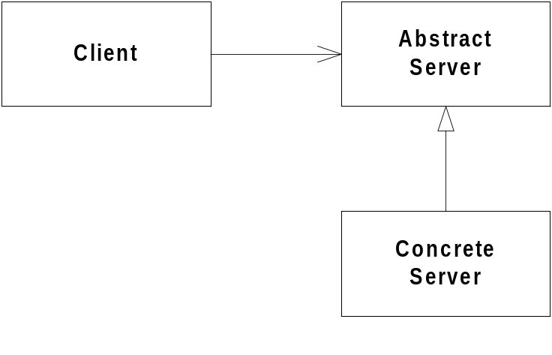
Abstraction is Key
Abstraction is the most important word in OOD
Client/Server relationships are “open”
Changes to servers cause changes to clients
Abstract servers “close” clients to changes in implementation.
Notes:
This effect is also the trick that makes C “function prototypes” useful. By depending on abstractions, we have greater freedom to change implementations. The C version works at link-time, but the OO version actually works at runtime also (polymorphism).
Notice that what happened above is a splitting of the server into an abstract, reliable part, and a concrete changeable part.
If a system is built on this principle, then a certain set of changes may be built by adding concrete implementations of classes without affecting the clients of their abstract interfaces.
This is also an important part of COM and CORBA.

Slide 28

The Shape Example
Procedural (not closed) implementation
OO (closed) implementation

Slide 29
Procedural (open) version
Shape.h
DrawAllShapes.c
enum ShapeType {circle, square};
struct Shape
{enum ShapeType itsType;};
#include <Shape.h>
#include <Circle.h>
#include <Square.h>
typedef struct Shape* ShapePtr;
void
DrawAllShapes(ShapePtr list[], int n)
{
int i;
for( i=0; i< n, i++ )
{
ShapePtr s = list[i];
switch ( s->itsType )
{
case square:
DrawSquare((struct Square*)s);
break;
case circle:
DrawCircle((struct Circle*)s);
break;
}
}
}
Circle.h
struct Circle
{
enum ShapeType itsType;
double itsRadius;
Point itsCenter;
};
void DrawCircle(struct Circle*)
Square.h
struct Square
{
enum ShapeType itsType;
double itsSide;
Point itsTopLeft;
};
void DrawSquare(struct Square*)

Slide 30
What is wrong with the code?
It can be demonstrated to work. Isn’t that the important thing?
DrawAllShapes is not closed.
  Switch/case tend to recur in diverse places.
  If we add a shape, we add to the switch/case
  All switch/case statements must be found and editd.
  Switch/Case statements are seldom this tidy
  When we add to the enum, we must rebuild everything
The software is both rigid and brittle
Notes:
In many systems, we can see the same structure, without even having separate functions for the different shapes -- it’s all in the switch-case statements.
Most common edit error? Probably forgetting the “break”.
If you know where all the switch/case statements are, by the time you get done editing them there will probably be another. It will probably be checked in after you check yours in, by someone with no knowledge of your changes.
We suggest that switch/case statements are a lot like cockroaches. If you see one, you’ve got dozens more hiding in dark corners and crevices.

Slide 31
A Closed Implementation
Circle.h
Shape.h
Class Shape
{
public:
virtual void Draw() const =0;
};
Class Circle: public Shape
{
public:
virtual void Draw() const;
};
DrawAllShapes.cpp
Square.h
#include <Shape.h>
void
DrawAllShapes(Shape* list[],int n)
{
for(int i=0; i< n; i++)
list[i]->draw();
}
Class Square: public Shape
{
public:
virtual void Draw() const;
};
Notes:
Here, DrawAllShapes is closed against modifications, in that adding a new shape does not require making any edits to DrawAllShapes.cpp.
Notice that there is only a dependency on shape.h. The DrawAllShapes routine doesn’t even know anything about circles and squares, but it works just fine anyway.
On comp.object, one contributor said that abstraction is “whittling away all of the reality you can stand to do without”. Here, we find that DrawAllShapes needs very little of the definition of a shape, and none of the details, to invoke the appropriate functionality.

Slide 32
Strategic Closure
No program is 100% closed.
Closure Against What?
  Closure is strategic. You have to choose which changes you’ll isolate yourself against.
  What if we have to draw all circles first? Now DrawAllShapes must be edited (or we have to hack something)
Opened Where?
  Somewhere, someone has to instantiate the individual shapes.
  It’s best if we can keep the dependencies confined
Notes:
You have to choose carefully what changes you will isolate the program from. You want to choose likely kinds of change, for which the cost of changes would be greater than the cost of isolation.
This requires experience, along with domain and technical knowledge. It requires a well-fed intuition.
Some code cannot help but be encumbered. The goal in that case is to do damage control, and focus changes into the simplest-possible routines which are easily discarded.
After all, eventually the rubber must meet the road.

Slide 33
Picking Targets
Technicians and domain users list
  Ways that the system is expected to change
  Ways that the system has already changed
Isolate these to kinds of changes, not specific changes
  schema changes
  sensor hardware changes
  data store technology
Keep this list handy throughout design
Don’t make the changes, just allow for them.
Notes:
An analyst may tag requirements as variable, or in variant. The development team may also want a list of areas to distrust. These areas would be candidates for living under an abstraction layer.
In Extreme Programming (XP), you don’t anticipate changes. Instead, when a change happens (like adding Triangle to the Shapes program), you add the change to the list of change types, and immediately refactor the code to make it easy to make another change of the same type.
For instance, the XP version may have started with squares, but when they added circles, they would have immediately abstracted ‘shape’ so that triangles, ovals, etc, would be added with a minimum of fuss.

Slide 34
Open/Closed Review
What does the open/closed principle say?
What does that mean practically?
How can it be achieved?
What is strategic closure?
  How can this be achieved in design?
  What if you can’t close completely?

Slide 35
Liskov Substitution Principle
Derived classes must be usable through the base class interface, without the need for the user to know the difference.
All derived classes must be substitutable for their base classes
This principle guides us in the creation of abstractions.
Notes:
Barbara Liskov works at MIT and is very influential in distributed computing circles. You can find some of her papers online at http://www.pmg.lcs.mit.edu/barbara_liskov.html. You can find more information on her Behavioral Notion of Subtyping online.

Slide 36
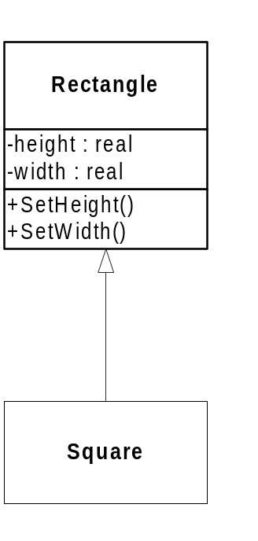
Square/Rectangle
A square is-a rectangle, right? So lets consider Square as a subtype of Rectangle.
We can make it work:
void Square::SetWidth(double w)
{
width = w;
height = w;
}
void Square::SetHeight(double h)
{
width = h;
height = h;
}
Uh, oh. This
doesn’t quite seem to fit

Slide 37
Substitution… denied!
It is reasonable for users of a rectangle to expect that height and width may change independently.
These expectations are preconditions and postconditions
  Bertrand Meyer calls it “Design by Contract”
  Post condition contract for rectangle is
    width = new Width
    height = old height
Square violates Rectangle’s contract
Notes:
This gives a new concept to us: the expectations of the users of an interface are the ones who must be satisfied by each new derivative. This means that inheritance is not just a relationship between two classes, but between the derivative and all of the users of the base.
Fulfilling the prototypes for the messages is not enough to fool the clients. If a user of ‘rectangle’ can reasonably assume from the interface that the X and Y can be changed independently, and then it receives a square, it will not receive the anticipated service. Instead, all such clients will have to be modified to first check to see if the rectangle is a square rectangle before operating on it.
The problem is no better if rectangle derives from square.
Not to fear, though. There are ways to share code other than inheritance. You don’t have to inherit to share code, and you don’t have to inherit in order to represent similarities in structure.
What happens to be true in mathematics is out of context in our app. In mathematics, things ‘are’. In OO, things ‘do’. It’s not physical structure, but expectations and behavior that matter in OO designs.
“square is a rectangle” is true, but not very useful.

Slide 38
Liskov Substitution Principle (cont.)
A client of rectangle expects height and width to be changed independently
  void setAspectRatio( Rectange* r, double ratio );
By deriving Square from Rectangle, we are allowing someone to set the aspect ratio of a Square !
We can still make it work
  if ( typeid(r) == typeid(Rectangle) )
  Violates Open/Closed Principle !

Slide 39
Liskov Substitution Principle (cont.)
Design by Contract
  Bertrand Meyer
  Preconditions, postconditions, invariants
Rectangle's postconditions for setWidth()
  width = newWidth
  length = oldLength
Square can require no more of clients, nor promise any less
  Doesn't maintain invariant of length
  Violates the contract

Slide 40
LSP Guides the Creation of Abstractions
Abstractions do not stand alone
Abstractions don’t always conform to real world expectations
Violating LSP is tantamount to violating the OCP

Slide 41
LSP Review
What does the LSP state?
What is the risk if LSP is violated?
What is Design by Contract?

Slide 42
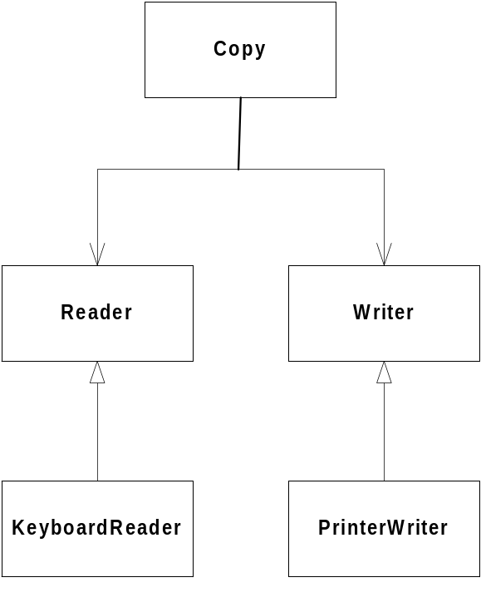
Dependency Inversion Principle
Details should depend on abstractions. Abstractions should not depend on details.
V.
Notes:
a.k.a Depend on abstractions principle
This is a matter of focus. We are more interested in the dependencies between objects rather objects themselves.
Don’t do this blindly

Slide 43
DIP Implications
Everything should depend upon abstractions
Avoid deriving from concrete classes
Avoid associating to concrete classes
Avoid aggregating concrete classes
Avoid dependencies on concrete components
Notes:
If software exists to map a process onto a platform, and is written to requirements, then the only reasons for software to change are changes to requirements or changes to the platform -- which are usually embodied in concrete classes.
Concrete classes, then, are detail-oriented, and subject to a generally higher rate of change than well-defined abstractions.
There are exceptions. Those classes that Meilir Page-Jones calls “foundation domain classes” (int, long, float, list, etc) might be reliable in a given circumstance. We recommend initial distrust, but some of these foundation domain classes are static enough through long use to be somewhat reliable.
Foundation domain objects do sometimes change when porting or accepting upgrades to compilers or platforms. Do be wary. The rules still hold.

Slide 44
Dependency Inversion Principle (cont.)
Legitimate reasons to violate
  Creation of objects
    new Circle creates a dependency on concrete class
    localize these dependencies using factories
  Nonvolatile classes
    string, vector, etc.
      providing they are stable

Slide 45
Interface Segregation Principle
Helps deal with “fat” or inappropriate interfaces
Sometimes class methods have various groupings.
These classes are used for different purposes.
Not all users rely upon all methods.
This lack of cohesion can cause serious dependency problems
These problems can be refactored away.

Slide 46
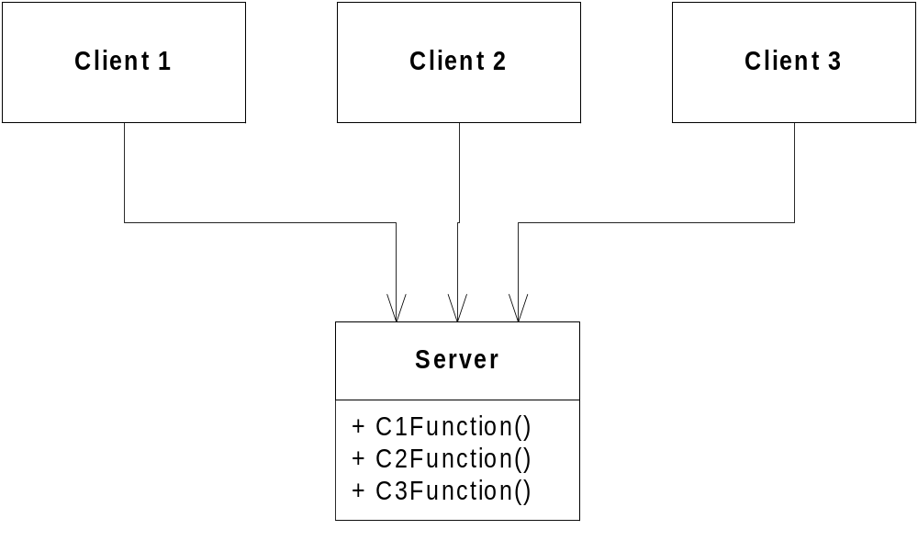
Interface Pollution by “collection”
Distinct clients of our class have distinct interface needs.
Notes:
Sometimes there are aspects of a system that are common, but the interfaces to this common aspect are unique to the clients. Error logs are sometimes this way, as are error displays, interfaces to UI devices, databases, etc.
In this arrangement, we are in real trouble.
If we add a fourth client, the interfaces needed to support the fourth client are edited onto the server interface. This causes all three of the existing clients to be recompiled, or perhaps edited. That’s a violation of the OCP.
Also, it could be that the Server needs to modify the Client1Interface in order to better serve Client 1. This is troublesome, because it affects clients 2 and 3.
In dynamically-typed languages, the collection of methods merely defocuses the objects and subtle variations in method names may complicate maintenance. Either way, the situation is uncomfortable.
We need to segregate these interfaces much as we did the interfaces for timers and doors.

Slide 47
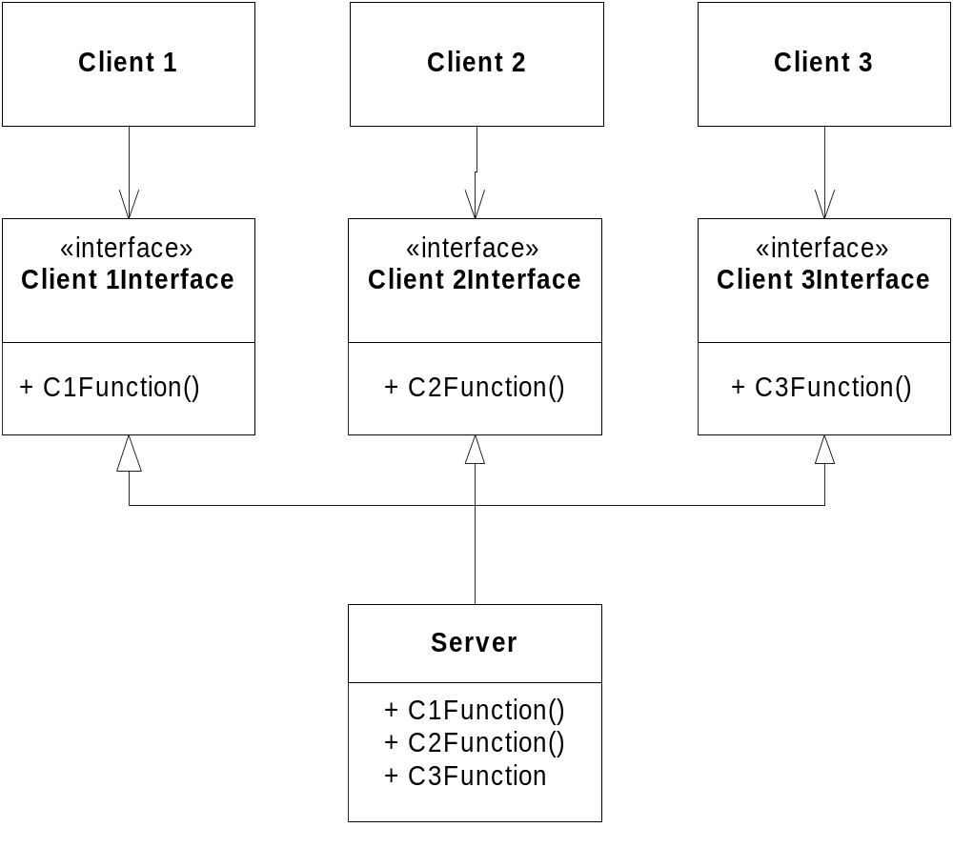
A Segregated Example
Notes:
Now changes to interfaces only affect the clients which depend directly on that interface, and the object that implements the interface.
It is also not necessary that the implementations are multiply-inherited and implemented in a single class anymore. The clients are unaware of the detailed implementation, so we can split the server in the future.
By segregating interfaces, we isolate dependent modules from one another. This is good DM, and good OOD.
Yes, we end up with more, smaller classes.

Slide 48
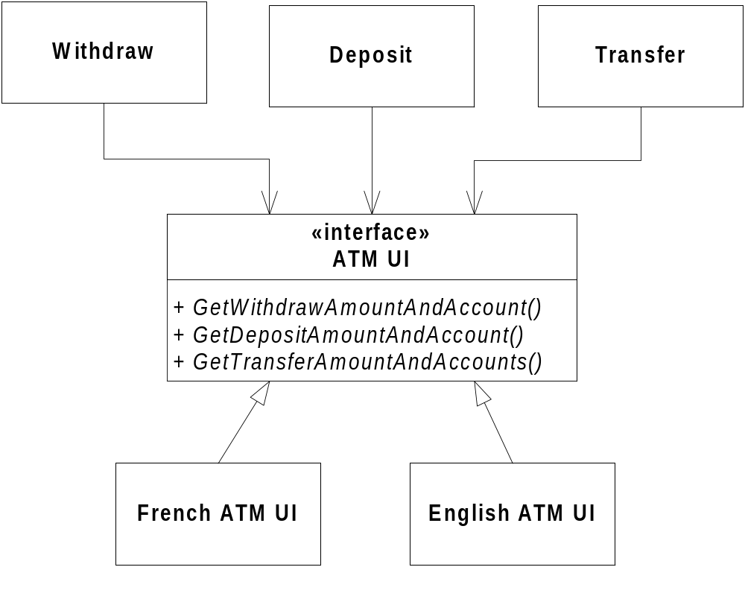
ATM UI Example
Notes:
What happens when we want to add a new transaction, one to pay the gas bill?

Slide 49
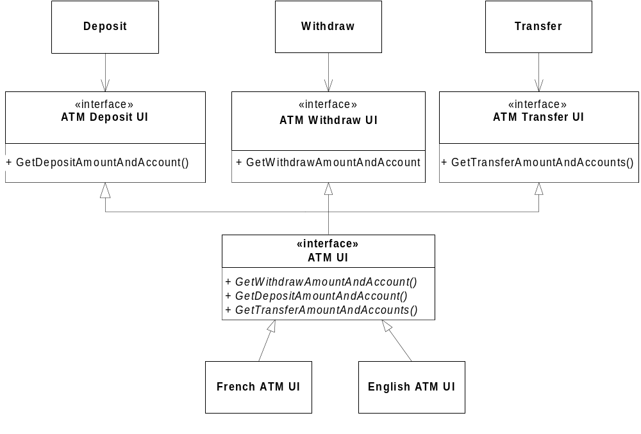
A Segregated ATM UI Example
Notes:
To keep deposit, withdraw, and transfer independent, they need to have their own interface to the UI. This adds classes and complexity, but may be worth it from an dependency management point of view. It is especially important if the clients are created by another company, or organization within the same company.

Slide 50
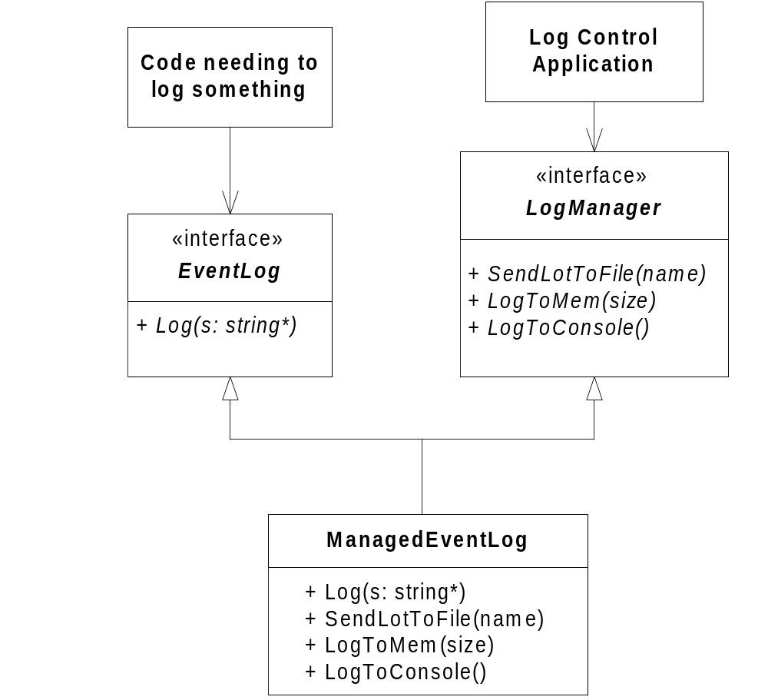
Logger Example
Notes:
Now changes to interfaces only affect the clients which depend directly on that interface, and the object that implements the interface.
It is also not necessary that the implementations are multiply-inherited and implemented in a single class anymore. The clients are unaware of the detailed implementation, so we can split the server in the future.
By segregating interfaces, we isolate dependent modules from one another. This is good DM, and good OOD.
Yes, we end up with more, smaller classes.

Slide 51
ISP Review
What is the ISP?
What does it affect?
How do these problems arise?
Does it really provide a real solution or just a restructuring of the problem?
When is it worth the effort?

Slide 52
Four Class Design Principles - Review
OCP Extend function without editing code
LSP Child instances substitute cleanly for base
DIP Depend on abstractions instead of details
ISP Split interfaces to manage dependencies

